Slide 1


KS4 Mathematics
N1 HCF and LCM

Slide 2

The lowest common multiple
The lowest common multiple (or LCM) of two numbers is the smallest number that is a multiple of both the numbers.
For small numbers we can find this by writing down the first few multiples for both numbers until we find a number that is in both lists.
For example,
Multiples of 20 are :
20,
40,
60,
80,
100,
120, . . .
Multiples of 25 are :
25,
50,
75,
100,
125, . . .
The LCM of 20 and 25 is
100.
Notes:
You may like to add that if the two numbers have no common factors (except 1) then the lowest common multiple of the two numbers will be the product of the two numbers.
For example, 4 and 5 have no common factors and so the lowest common multiple of 4 and 5 is 4 × 5, 20.
Pupils could also investigate this themselves later in the lesson.

Slide 3
The lowest common multiple
We use the lowest common multiple when adding and subtracting fractions.
For example,
4
and
5
Add together
9
12
The LCM of 9 and 12 is 36.
× 4
× 3
4
5
16
15
31
+
=
+
=
9
12
36
36
36
× 4
× 3
Notes:
Establish by asking for multiples that the lowest common multiple of 9 and 12 is 36.
Remind pupils that to add two fractions together they must have the same denominator.
The LCM is the lowest number that both 9 and 12 will divide into.
Ask pupils how many 9s ‘go into’ 36. Establish that we must multiply 9 by 4 to get 36 before revealing the first arrow.
Now, we’ve multiplied the bottom by 4 so we must multiply the top by 4.
Remember, if you multiply the top and the bottom of a fraction by the same number, you do not change its value. ¹⁶/₃₆ is just another way of writing ⁴/_{9.}
Repeat this explanation as you convert ⁵/₁₂ to ¹⁵/₃₆.
¹⁶/₃₆ plus ¹⁵/₃₆ equals ³¹/₃₆. Can this fraction be simplified?
Establish that it cannot.

Slide 4
The highest common factor
The highest common factor (or HCF) of two numbers is the highest number that is a factor of both numbers.
We can find the highest common factor of two numbers by writing down all their factors and finding the largest factor in both lists.
For example,
Factors of 36 are :
1,
2,
3,
4,
6,
9,
12,
18,
36.
Factors of 45 are :
1,
3,
5,
9,
15,
45.
The HCF of 36 and 45 is
9.
Notes:
Point out that 3 is a common factor of 36 and 45. So is 1. But 9 is the highest common factor.

Slide 5
The highest common factor
We use the highest common factor when cancelling fractions.
For example,
36
Cancel the fraction
48
The HCF of 36 and 48 is 12, so we need to divide the numerator and the denominator by 12.
÷12
36
3
=
48
4
÷12
Notes:
Talk through the use of the highest common factor to cancel fractions in one step.

Slide 6
Using prime factors to find the HCF and LCM
We can use the prime factor decomposition to find the HCF and LCM of larger numbers.
For example,
Find the HCF and the LCM of 60 and 125.
2
60
2
294
2
30
3
147
3
15
7
49
5
5
7
7
1
1
60 = 2 × 2 × 3 × 5
294 = 2 × 3 × 7 × 7
Notes:
Recap on the method of dividing by prime numbers introduced in the previous section.

Slide 7
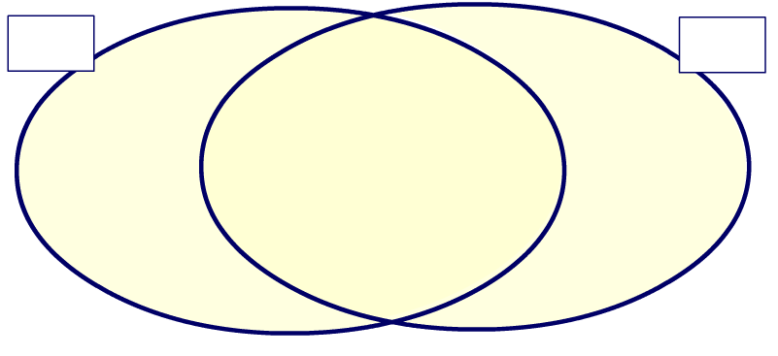
Using prime factors to find the HCF and LCM
60 = 2 × 2 × 3 × 5
294 = 2 × 3 × 7 × 7
60
294
2
2
7
5
3
7
HCF of 60 and 294 =
2 × 3
= 6
LCM of 60 and 294 =
2 × 5 × 2 × 3 × 7 × 7 =
2940
Notes:
We can find the HCF and LCM by using a Venn diagram.
We put the prime factors of 60 in the first circle. Any factors that are common to both 60 and 294 go into the overlapping section.
Click to demonstrate this. Point out that we can cross out the prime factors that we have included from 294 in the overlapping section to avoid adding then twice.
We put the prime factors of 294 in the second circle.
The prime factors which are common to both 60 and 294 will be in the section where the two circles overlap.
To find the highest common factor of 60 and 294 we need to multiply together the numbers in the overlapping section.
The lowest common multiple is found by multiplying together all the prime numbers in the diagram.

Slide 8
The LCM of co-prime numbers
If two numbers have a highest common factor (or HCF) of 1 then they are called co-prime or relatively prime numbers.
For two whole numbers a and b we can write:
a and b are co-prime if HCF(a, b) = 1
If two whole numbers a and b are co-prime then:
LCM(a, b) = ab
For example, the numbers 8 and 9 do not share any common multiples other than 1. They are co-prime.
Therefore,
LCM(8, 9) =
8 × 9 =
72
Notes:
Explain that if two numbers are co-prime, that is they do not share any common factors other than 1, their LCM is equal to the product of the two numbers.
This rule is also true if more than two numbers are co-prime. For example, the LCM of 3, 5 and 8 is 3 × 5 × 8 = 120.

Slide 9
The LCM of numbers that are not co-prime
If two numbers are not co-prime then their highest common factor is greater than 1.
If two numbers a and b are not co-prime then their lowest common multiple is equal to the product of the two numbers divided by their highest common factor.
We can write this as:
ab
LCM(a, b) =
HCF(a, b)
For example,
8 × 12
96
LCM(8, 12) =
=
= 24
HCF(8, 12)
4
Notes:
Repeat the activity on slide 62 verifying using this rule to check each solution.
Rearranging this formula, we can also say that the LCM(a,b) × HCM(a,b) = ab.
In other words, for any two whole numbers a and b, the LCM of a and b multiplied by the HCF of a and b equals the product of a and b.
This rule is true for any two whole numbers. If the two numbers are co-prime we have LCM (a,b) = ab/1, as on the previous slide.

